Slide 1
Distributed View of the System
hardware
hardware
hardware
Process
hardware
hardware

Slide 2
Distributed Operating Systems
Issues :
Global Knowledge
Naming
Scalability
Compatibility
Process Synchronization
Resource Management
Security
Structuring
Client-Server Model

Slide 3
DOS: Issues ..
Global Knowledge
Lack of global shared memory, global clock, unpredictable message delays
Lead to unpredictable global state, difficult to order events (A sends to B, C sends to D: may be related)
Naming
Need for a name service: to identify objects (files, databases), users, services (RPCs).
Replicated directories? : Updates may be a problem.
Need for name to (IP) address resolution.
Distributed directory: algorithms for update, search, ...

Slide 4
DOS: Issues ..
Scalability
System requirements should (ideally) increase linearly with the number of computer systems
Includes: overheads for message exchange in algorithms used for file system updates, directory management...
Compatibility
Binary level: Processor instruction level compatibility
Execution level: same source code can be compiled and executed
Protocol level: Mechanisms for exchanging messages, information (e.g., directories) understandable.

Slide 5
DOS: Issues ..
Process Synchronization
Distributed shared memory: difficult.
Resource Management
Data/object management: Handling migration of files, memory values. To achieve a transparent view of the distributed system.
Main issues: consistency, minimization of delays, ..
Security
Authentication and authorization

Slide 6
DOS: Issues ..
Structuring
Monolithic Kernel: Not needed (e.g.,) file management not needed fully on diskless workstations.
Collective kernel: distributed functionality on all systems.
Micro kernel + set of OS processes
Micro kernel: functionality for task, memory, processor management. Runs on all systems.
OS processes: set of tools. Executed as needed.
Object-oriented system: services as objects.
Object types: process, directory, file, …
Operations on the objects: encapsulated data can be manipulated.

Slide 7
DOS: Communication
Computer
Switch

Slide 8
ISO-OSI Reference Model
Application
Application
Presentation
Presentation
Session
Communication Network
Session
Transport
Transport
Network
Network
Network
Network
Datalink
Datalink
Datalink
Datalink
Physical
Physical
Physical
Physical

Slide 9
Un/reliable Communication
Reliable Communication
Virtual circuit: one path between sender & receiver. All packets sent through the path.
Data received in the same order as it is sent.
TCP (Transmission Control Protocol) provides reliable communication.
Unreliable communication
Datagrams: Different packets are sent through different paths.
Data might be lost or out of sequence.
UDP (User datagram Protocol) provides unreliable communication.

Slide 10
RPC Design
Structure
Caller: local call + stub
Callee: stub + actual procedure
Binding
Where to execute? Name/address of the server that offers a service
Name server with inputs from service specifications of a task.
Parameter & results
Packing: Convert to remote machine format
Unpacking: Convert to local machine format

Slide 11
RPC Execution
Binding
Server
Register
Services
Receive
Query
Local Proc.
Stub
Stub
Remote Proc.
Local
call
Query
binding
server
Return
Server Address
Unpack
Execute
procedure
Params
packing
Local
call
Wait
Unpack
result
Pack
results
Return
Return
Caller
Callee

Slide 12
RPC Semantics
At least once
A RPC results in zero or more invocation.
Partial call, i.e., unsuccessful call: zero, partial, one or more executions.
Exactly once
Only one call maximum
Unsuccessful? : zero, partial, or one execution
At most once
Zero or one. No partial executions.

Slide 13
RPC Implementation
Sending/receiving parameters:
Use reliable communication? :
Use datagrams/unreliable?
Implies the choice of semantics: how many times a RPC may be invoked.

Slide 14
RPC Disadvantage
Incremental results communication not possible: (e.g.,) response from a database cannot return first few matches immediately. Got to wait till all responses are decided.

Slide 15
CLOCKS

Slide 16
Theoretical Aspects
Logical Clocks
Causal Ordering
Global State Recording
Termination Detection

Slide 17
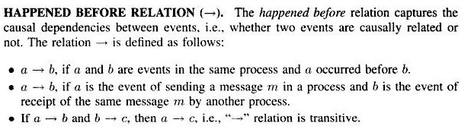
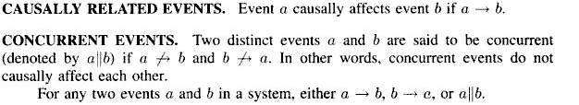
LAMPORT’s LOGICAL CLOCKS

Slide 18
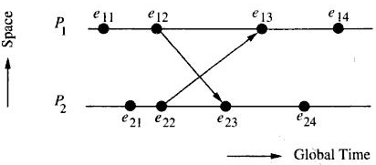
Space Diagram

Slide 19
Logical Clocks:
Each process P_{i} has a clock C_{i}
Clock C_{i} is a function that assigns a number C_{i}(a) called timestamp to any event a.
The number assigned by clock has no relation with physical time
Clocks can be implemented by using counters

Slide 20
Conditions Satisfied by the System of Clock:
If a → b then C(a) < C(b)
conditions to be met for Happened before relation :
[C1] for any two events ‘a’ and ‘b’ in P_{i,} if a occurs before b then, C_{i}(a) < C_{i}(b)
[C2] If a is the event of sending message m in P_{i} and b is event of receiving m in P_{j} , then C_{i}(a) < C_{j}(b)

Slide 21
Implementation rules (IR) for the clocks:
[IR1] Clock C_{i} is incremented between any two successive events in Process P_{i} :
C_{i} := C_{i} + d (d > 0) (5.1)
[IR2] Event a is sending a message m from P_{i} with timestamp t_{m} = C_{i}(a).
P_{j} on receiving m sets C_{j} as
C_{j} := max(C_{j}, t_{m} + d); (d > 0); (5.2)

Slide 22
Total ordering ( ) of set of events in distributed computation can be done using system clocks :
If a is an event of P_{i} and b is an event of P_{j},
then a b if and only if
C_{i}(a) < C_{j}(b) or
C_{i}(a) = C_{j}(b) and P_{i} P_{j}
Where relation - totally orders processes to break ties

Slide 23
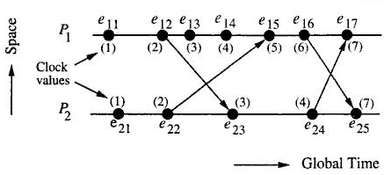
Example showing how lamport’s logical clocks advance

Slide 24
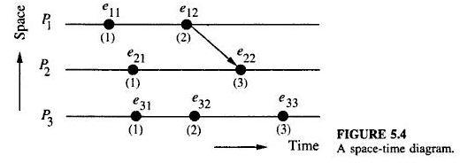
Limitation of Lamport’s Clocks
If a and b are events in different processes and if
C(a) < C(b) then a→b may not be true
a and b may or may not be casually related

Slide 25
VECTOR CLOCKS
To keep track of transitive dependencies among processes for recovery purposes.
Implementation rules for vector clocks are:
[IR1] Clock C_{i} incremented between two successive events
C_{i}[i] = C_{i}[i] + d, (d > 0) (5.3)
[IR2] when a message m with time stamp tm is received by P_{j} from P_{i}
∀k, C_{j}[k] := max(C_{j}[k] , t_{m}[k]) (5.4)

Slide 26
If it is necessary to allow propagation time for a message, then IR2 must be performed after following step:
if C_{j}[i] ≤ t_{m}[i]
then C_{j}[i] := t_{m}[i] + d, (d > 0)
Assertion: At any instant
∀i, ∀j : C_{i}[i] ≥ C_{j}[i]

Slide 27
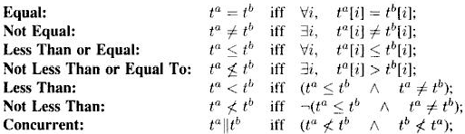
Vector Timestamp Comparison
For any two timestamps tª and t^{b} of events a and b
Note: Relation ‘≤’ is partial order and
relation ‘ǁ’ is not partial order

Slide 28
Casually Related Events:
Events a and b are :
casually related, if
tª < t^{b} or t^{b} < tª
concurrent (otherwise)
tª ǁ t^{b}

Slide 29
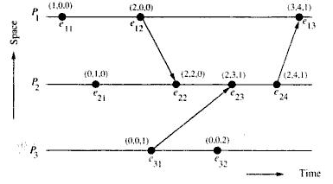
Dissemination of time in vector clocks

Slide 30
In the system of vector clocks
a → b iff tª < t^{b} (5.5)
Vector clock allows to:
order events
Decide whether two events are casually related
Event e casually affects e’, if there exists a path that propagates time knowledge of event e to e’

Slide 31
CASUAL ORDERING OF MESSAGES
Was proposed by Birman and Joseph and was implemented in ISIS
It maintains the casual relationship between “message send” and corresponding “message receive “
If Send(M₁) → Send(M₂)
then all recipients must receive M₁ before M₂

Slide 32
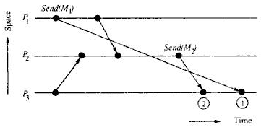
An Example of the violation of casual ordering of messages

Slide 33
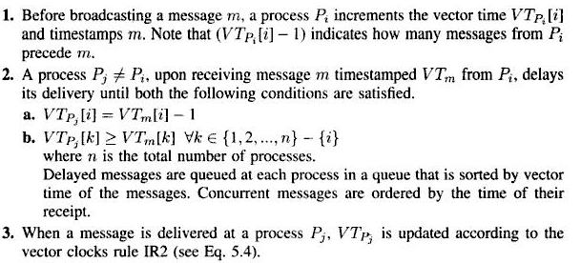
BIRMAN-SCHIPER-STEPHENSON PROTOCOL
The protocol is deadlock free since event ordering relation “→” imposed by vector clocks is acyclic

Slide 34
SCHIPER-EGGLI-SANDOZ PROTOCOL
Data Structures :
Each process P maintains a vector V_P of size (N-1) ; where N - number of process
Each element of V_P is an ordered pair (P’, t) ;
where P’ - destination process ID and
t - vector timestamp ( each process has vector clock)
Notations:
t_{M} – logical time at sending of message M
t_{Pi} – present/current logical time at process P_{i}

Slide 35
The Protocol
Sending of a message M from process P₁ to process P₂
Send message M (timestamped t_{M}) and V_P₁ to P₂
Insert (P₂, t_{M}) into V_P₁
if (P₂, t_{M}) is already there in V_P_{1,} it will be overwritten
Any future message carrying (P₂, t_{M}) cannot be delivered to P₂ until t_{M} < t_{P2}

Slide 36
Arrival of a message M at process P₂
If V_M does not contain any pair (P₂, t) then message can be delivered
else ( A pair (P₂, t) exists in V_M)
if t t_{P2} then
the message cannot be delivered
(it is buffered)
else
the message can be delivered

Slide 37
If message M can be delivered to process P_{2,} then following three actions are taken:
Merge V_M accompanying M with V_ P₂ :
(Ǝ(P, t) ϵ V_M such that P ≠ P₂ ) and
(∀(P’, t) ϵ V_ P_{2,} P’≠ P) then insert (P, t) into V_P₂
∀P, P ≠ P₂ , if ((P, t) ϵ V_M) ^ ((P’, t) ϵ V_P₂) ,
then the algorithm performs following actions :

Slide 38
- (P, t) ϵ V_P₂ is substituted by pair (P, t_{sup})
where t_{sup} is such that :
∀i, t_{sup}[i] := max(t[i] , t’[i])
- Due to the above actions, the algorithm satisfies following two conditions:
a) No message can be delivered to P as long as t’ < t_{p} is not true
b) No message can be delivered to P as long as t < t_{p} is not true

Slide 39
(ii) Update site P2’s logical clock
(iii) Check for buffered messages that can be delivered since clock is updated
Pair (P, t) is deleted from the vector maintained in the site after it becomes obsolete

Slide 40
GLOBAL STATE
Address the problem of recording coherent global state in distributed system
It is challenging due to absence of global clock and shared memory
Example:
$50 is transferred from account A to account B
Assume communication channels C1 and C2 are FIFO

Slide 41
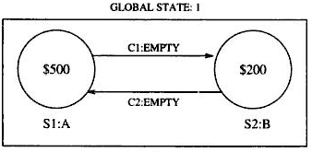
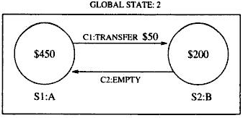
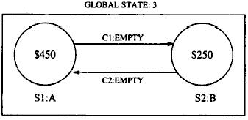
Global States and their transitions

Slide 42
n – number of messages sent by A along channel before A’s state was recorded
n’ – number of messages sent by A along channel before channel’s state was recorded
A global state is consistent if
n = n’ (5.6)

Slide 43
m’ – number of messages received by B along channel before B’s state was recorded
m – number of messages received by B along channel before channel’s state was recorded
A global state is consistent if
m = m’ (5.7)

Slide 44
Number of messages sent cannot be less than number of messages received along a channel
n’ ≥ m (5.8)
From equations 5.6 and 5.8
n ≥ m (5.9)
A consistent global state must satisfy 5.9

Slide 45
Definitions:
Local State : for a site(computer) S_{i}, its local state at a given time is defined by the local context of the distributed application.
Let:
send(m_{ij}) – send event of message m_{ij} from
S_{i} to S_{j} and
rec(m_{ij}) – receive event of message m_{ij} by S_{j}
time(x) – time at which state x was recorded
time(send(m)) – time at which event send(m) occured

Slide 46
send(m_{ij}) ϵ LS_{i} iff time(send(m_{ij})) < time(LS_{i} )
rec(m_{ij}) ϵ LS_{j} iff time(rec(m_{ij})) < time(LS_{j} )
For local states LS_{i} and LS_{j} of any two sites S_{i} and S_{j} two sets of messages are defined which contains messages sent from site S_{i} and S_{j.}

Slide 47
Transit:
transit(LS_{i} , LS_{j} ) = {m_{ij} | send(m_{ij}) ϵ LS_{i} ^ rec(m_{ij}) ∉ LS_{j}
Inconsistent:
Inconsistent(LS_{i} , LS_{j} ) = {m_{ij} |send(m_{ij}) ∉ LS_{i} ^ rec(m_{ij}) ϵ LS_{j}

Slide 48
Global State(GS)
of a system is a collection of local states of its sites
GS = {Ls₁ , LS₂ , …. , LS_{n} }
where, n - number of sites
Consistent global state:
A global state is consistent iff

Slide 49
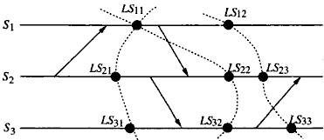
Global states in a distributed computation
Note:
{Ls₁₂ , LS₂₃ , LS₃₃} - consistent
{Ls₁₁ , LS₂₂ , LS₃₂} - inconsistent

Slide 50
Transitless global state:
A global state is transitless iff
Strongly Consistent Global State :
A global state is strongly consistent if it is:
- consistent
- transitless

Slide 51
Chandy-Lamport’s Global State Recording Algorithm
The algorithm uses a marker (special message)
Recorded global state is referred to as snapshot of system
Marker Sending Rule for a process P
P records its state
For each outgoing channel C from P on which marker has not been sent, P sends a marker along C before sending further messages

Slide 52
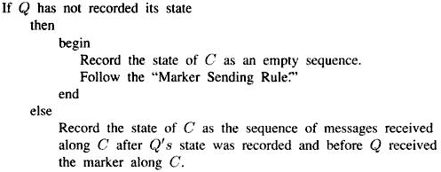
Marker Receiving Rule for a process Q
On receipt of a marker along a channel C

Slide 53
Initiation of marker can be done by any process, with its own unique marker:
<process id, sequence number>
Several processes can initiate state recording by sending markers. Concurrent sending of markers allowed.
One possible way to collect global state: all processes send the recorded state information to the initiator of marker. Initiator process can sum up the global state.

Slide 54
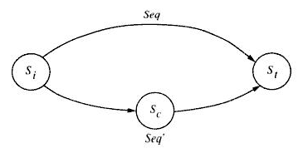
A property of a collected global state

Slide 55
CUTS OF A DISTRIBUTED COMPUTATION
CUT
A cut of distributed computation C = {c₁,c₂,..c_{n}} where c_{i} is cut event at site S_{i.}
Cut is a zig-zag line connecting corresponding cut events

Slide 56
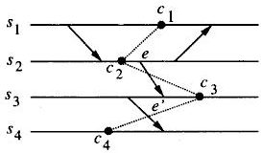
Example for a cut

Slide 57
Consistent Cut
e_{k} denotes an event at site S_{k}
Cut C = {c₁,c₂,..c_{n}} is consistent cut iff
where c_{i} ϵ C and c_{j} ϵ C

Slide 58
A set of concurrent cut events form a consistent cut and vice versa
Theorem 1:
A Cut C = {c₁,c₂,..c_{n}} is a consistent cut if and only if no to cut events are casually related.
that is,

Slide 59

A cut where cut events are not concurrent
c₁ and c₂ are not concurrent

Slide 60
Time of a cut
If each cut event is assigned a vector timestamp then a cut can be assigned a timestamp as follows:
If C = {c₁,c₂,..c_{n}} is a cut with vector timestamp Vt_{ci},
then Vector time of the cut, VT_{c} is defined as
VT_{c} = sup(VT_{c1}, VT_{c2}, .., VT_{cn}).
sup is a componentwise maximum operation
VT_{c}[i] = max(VT_{c1}[i], VT_{c2}[i], .., VT_{cn}[i]).

Slide 61
Theorem 2
If C = {c₁,c₂,..c_{n}} is a cut with vector time Vt_{c}, then the cut is consistent iff
VT_{c} = (VT_{c1}[1], VT_{c2}[2], .., VT_{cn}[n])
Proof:
if C is consistent cut then from Theorem1, events c₁,c₂,..c_{n} are concurrent.
that is ∀i∀j, C_{i}[i] ≥ C_{j}[i]
therefore,
sup(VT_{c1}, VT_{c2}, .., VT_{cn}) = (VT_{c1}[1], VT_{c2}[2], .., VT_{cn}[n])

Slide 62
TERMINATION DETECTION
Distributed computation consists of a set of cooperating processes that communicate with each other
Hence termination of computation is important
Example: leader election, deadlock detection, deadlock resolution etc.

Slide 63
System Model
A process may be active or idle
Only an active process can send message
Idle process become active on receiving a computation message
Computation is terminated if and only if all processes are idle and no message is in transit

Slide 64
Basic Idea
Controlling agent – one of the cooperating processes that monitors computation
– its weight is 1
– weight of all other process is zero
Computation starts when controlling agent sends computation message
When a process sends a message - process’s weight is split between itself and process receiving message

Slide 65
The algorithm assigns weight W (0 < W ≤ 1) to each active process and each message in transit
Weights are assigned, such that ΣW = 1
On finishing computation, process sends its weight to controlling agent
Controlling agent adds received weight to its own weight
Controlling agent concludes that a computation is terminated when its weight becomes 1

Slide 66
Notations used in the Algorithm B(DW) = Computation message sent as a part of computation and DW is the weight assigned to it
C(DW) = Control message sent from the process to the controlling agent and DW is the weight assigned to it

Slide 67
Huang’s Termination Detection Algorithm
Rule 1: The controlling agent or an active process having weight W sends a computation message to a process P by doing:
Derive W₁ and W₂ such that
W₁ + W₂ = W, W₁ > 0, W₂ > 0;
W := W₁ ;
Send B(W₂) to P;

Slide 68
Rule 2: on receipt of B(DW) , a process P having weight W does:
W := W + DW;
if P is idle P becomes active
Rule 3: An active process having weight W become idle at any time by doing:
Send C(DW) to the controlling agent;
W := 0;
(Process becomes idle);

Slide 69
Rule 4: on receipt of C(DW) , the controlling agent having weight W takes following actions:
W := W + DW;
if W = 1 conclude computation is terminated

Slide 70
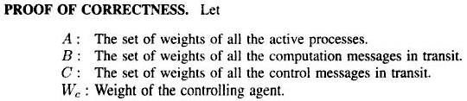
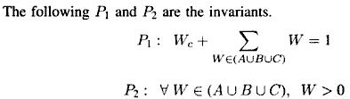

Slide 71
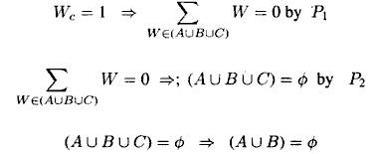

Hence,
A U B = ф implies termination of computation
We can verify that the algorithm never detects false termination

Slide 72
DISTRIBUTED MUTUAL EXCLUSION

Slide 73
Mutual Exclusion
Access to shared resource by several un-coordinated user requests must be serialized
Actions performed on shared resource on user behalf must be atomic
Examples : Directory Management – where update to the directory must be atomic

Slide 74
Classification of Mutual Exclusion Algorithms
Non-token based:
A site/process can enter a critical section when an assertion (condition) becomes true.
Algorithm should ensure that the assertion will be true in only one site/process.

Slide 75
Token based:
A unique token (a known, PRIVILEGE message) is shared among cooperating sites/processes.
Possessor of the token has access to critical section.
Need to take care of conditions such as loss of token, crash of token holder, possibility of multiple tokens, etc.

Slide 76
General System Model
At any instant, a site may have several requests for critical section (CS), queued up, and serviced one at a time.
Site States:
Requesting CS: blocked until granted access, cannot make additional requests for CS.
Executing CS: using the CS.
Idle: action is outside the site. In token-based approaches, idle site can have the token.

Slide 77
Requirements of Mutual Exclusion Algorithms
Freedom from deadlocks: two or more sites should not endlessly wait on conditions/messages that will never arrive.
Freedom from starvation: No indefinite waiting to execute CS
Fairness: Order of execution of CS follows the order of the requests for CS. (equal priority).
Fault tolerance: the mutual exclusion algorithm must be able to reorganize itself in the wake of

Slide 78
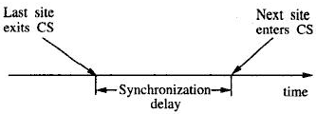
Performance Metrics
Number of messages per CS invocation: should be minimized.
Synchronization delay: time between the leaving of CS by a site and the entry of CS by the next one.
should be minimized ( shown below)

Slide 79
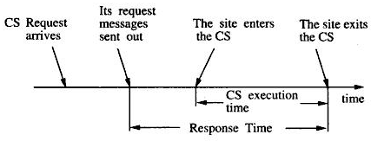
Response time: time interval between completion of CS execution and request messages sent.
Following figure shows Response Time

Slide 80
System throughput: rate at which system executes requests for CS.
should be maximized.
If sd is synchronization delay, E the average CS execution time:
system throughput = 1 / (sd + E)

Slide 81
Low and High Load:
Performance depends on load on the system
Low load: Rarely more than one request for mutual exclusion simultaneously exists in system
High load: Always a pending request for mutual exclusion exists at a site.

Slide 82
Best and Worst Case:
Best Case (low loads): Round-trip message delay + CS Execution time. 2T + E
Worst case (high loads)
Average performance: when performance metrics fluctuate statistically.

Slide 83
Simple Solution to Distributed Mutual Exclusion
Control site: grants permission for CS execution.
A site sends REQUEST message to control site.
Control Site queues up requests and grants access one by one.
This method requires only three messages per CS execution

Slide 84
Drawbacks
Single point of failure (Control site)
Control site may be flooded with extra work
Synchronization delay is 2T -> A site release CS by sending message to controller and controller sends permission to another site.
System throughput is 1/(2T + E). If synchronization delay is reduced to T, throughput doubles.

Slide 85
Non-Token-Based Algorithms
A site communicates with a set of other sites to decide who should execute CS next
Each site S_{i} maintains a request set R_{i}
R_{i} - contain ids of all sites from whom S_{i} must acquire permission before entering the CS
They use timestamps to order requests

Slide 86
Lamport’s Algorithm
Lamport was first to give distributed mutual exclusion algorithm
Every site S_{i} keeps a queue, request_queue_{i}
- which contains mutual exclusion requests ordered by their timestamps

Slide 87
Algorithm
Requesting the Critical Section:
Site S_{i} Send REQUEST(t_{si}, i) to all sites in R_{i} and Place REQUEST in request_queue_{i}
where,(t_{si}, i) - timestamp of the request.
Site S_{j} On receiving the message from S_{i} sends timestamped REPLY message to S_{i}.
- places S_{i}’s request on request_queue_{j}.

Slide 88
Executing the Critical Section:
- S_{i} enters CS when following two conditions hold:
[L1] : S_{i} has received a message with time stamp larger than (t_{si},i) from all other sites.
[L2] : S_{i} ’s request is at the top of request_queue_{i}.

Slide 89
Releasing the Critical Section:
Site S_{i} upon exiting CS:
Removes its request from top of request queue
Sends a timestamped RELEASE message to all sites in its request queue
(4) When S_{j} receives a RELEASE message from S_{i}, it removes S_{i}’s request from its queue.

Slide 90
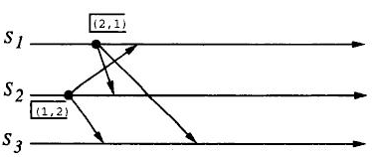
Operation of Lamport’s Algorithm

Slide 91
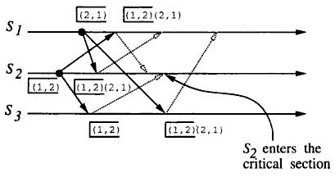

Slide 92
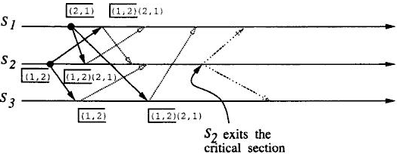

Slide 93
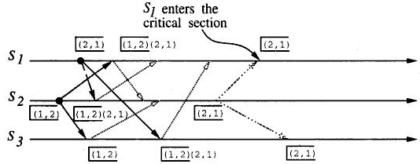

Slide 94
Performance.
It requires 3(N-1) messages per CS invocation.
- (N - 1) REQUEST messages
- (N - 1) REPLY messages
- (N - 1) RELEASE messages
Synchronization delay in the algorithm is ‘T’

Slide 95
Optimization
Lamport’s algorithm can be optimized to require between 3(N-1) and 2(N-1) messages
By suppressing REPLY messages
Example :
- S_{j} receives a REQUEST message from S_{i} after sending its own REQUEST message with timestamp higher than that of S_{i}’s
- S_{j} need not send REPLY message

Slide 96
Ricart-Agrawala Algorithm
It is an optimized version of Lamport’s algorithm
This algorithm also

Slide 97
Algorithm
Requesting critical section
1. if S_{i} wants to enter CS, it sends timestamped REQUEST message to all sites in request set
2. When site S_{j} receives REQUEST message from S_{i} ,
it sends REPLY to S_{i}, if
S_{j} is neither requesting nor executing CS
or
S_{j} is requesting CS and S_{i}’s time stamp is smaller than its own request.
Request is deferred otherwise.

Slide 98
Executing the Critical Section :
3. Site S_{i} enter CS after it has received REPLY from all sites in its request set
Releasing the Critical Section :
4. when site S_{i} exits , it sends REPLY to all deferred requests
A site’s REPLY messages are blocked only by sites that request CS with higher priority

Slide 99
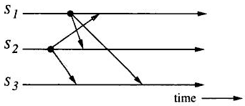
Operation of Ricart- Agrawala Algorithm

Slide 100
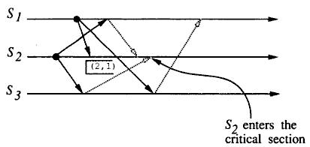

Slide 101
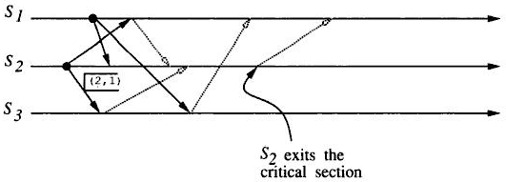

Slide 102
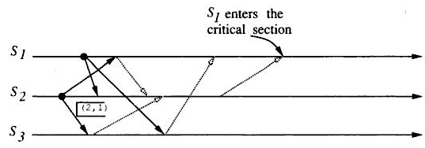

Slide 103
Performance:
2(N-1) messages per CS execution
- (N-1) REQUEST and
- (N-1) REPLY.
Synchronization delay is T.

Slide 104
Optimization :
Proposed by Roucairol and Carvalho
When S_{i} receives REPLY message from S_{j} implicit authorization to access CS remains valid
When S_{i} receives REPLY from S_{j},
S_{i} can enter its CS any number of times without requesting permission from S_{j} until it sends REPLY.
A site requests permission from dynamically varying set of sites and requires 0 to 2(N-1) messages per CS

Slide 105
Maekawa’s Algorithm
Here a site requests permission only from a subset of sites.
Request set of each site is chosen such that
A site can send only one REPLY message at a time,
- a site can send a REPLY message only after receiving a RELEASE message for the previous REPLY message
Site S_{i} locks all sites in R_{i} in exclusive mode

Slide 106

Construction of Request Sets :
Request sets are constructed to satisfy the following conditions:
Relation between N and K:
N = K(K - 1) + 1
That is |R_{i}| = √N

Slide 107
The Algorithm
Requesting the Critical Section
1. S_{i} sends REQUEST(i) to all sites in its request set R_{i}.
2. S_{j} sends REPLY(j) to S_{i} if, S_{j} has NOT sent a REPLY message to any site from the time it received the last RELEASE message.
- Otherwise it queues up S_{i}’s request.

Slide 108
Executing the Critical Section:
3. S_{i} executes CS after getting REPLY messages from all sites in R_{i}.
Releasing the Critical Section:
After execution of CS, S_{i} sends RELEASE(i) to all sites in R_{i}
When a site S_{j} receives RELEASE(i) from S_{i}, it sends REPLY message to the next site in queue and deletes that entry from queue .
- If queue empty, then it updates its status indicating that it has not sent any REPLY message.

Slide 109
Performance
Size of the request is √N; hence execution of a CS requires :
√N REQUEST
√N REPLY
√N RELEASE
3 √N messages per CS execution
Synchronization delay: 2T

Slide 110
Problem of Deadlocks
Maekawa’s algorithm is prone to deadlocks :
A site is exclusively locked by other sites
Requests are not prioritized by their timestamps
Assume three sites S_{i}, S_{j}, S_{k} simultaneously invoke mutual exclusion
Let
R_{i}∩ R_{j} = {S_{ij}}, R_{i}∩ R_{k} = {S_{jk}}, and R_{k}∩ R_{i} = {S_{ki}},

Slide 111
It is possible that due to arbitrary message delays:
S_{ij} is locked by S_{i} (forcing S_{j} to wait at S_{ij})
S_{jk} by S_{j} (forcing S_{k} to wait at S_{jk})
S_{ki} by S_{k} (forcing S_{i} to wait at S_{ki})
Results in deadlocks among S_{i}, S_{j}, and S_{k}.

Slide 112
Handling Deadlocks
A site yields its lock to some other request ,waiting for same lock with a smaller timestamp than itself.
A site suspects a deadlock when a high priority request finds that the site is locked by a request with lower priority.

Slide 113
Deadlock handling requires following three types of messages:
FAILED: FAILED message from S_{i} to S_{j} -> S_{i} has already granted permission to higher priority request.
INQUIRE: from S_{i} to S_{j} -> S_{i} would like to know if S_{j} has succeeded in locking all sites in S_{j}’s request set.
YIELD: from S_{i} to S_{j} -> S_{i} is returning permission to S_{j}

Slide 114
Deadlock handling steps:
When a REQUEST(ts, i) from site S_{i} is blocked at S_{j} because S_{j} has granted permission to site S_{k} :
S_{i} sends FAILED(j) to S_{i}, if S_{i}’s request has lower priority (higher time stamp)
Otherwise, S_{i} sends INQUIRE(j) to S_{k}.
When S_{k} receives INQUIRE(j) from site S_{j,} the site S_{k} sends YIELD(k) to S_{j} if
S_{k} has received a FAILED message from a site in its request set or
S_{k} sent a YIELD to any of these sites and has not received a new REPLY

Slide 115
When site S_{j} receives YIELD(k) from S_{k} :
S_{j} assumes it has been released by S_{k},
places Sk’s request in its queue appropriately,
sends a REPLY(j) to the top request’s site in its queue.
Maekawa-type algorithms may exchange these messages even if there is no real deadlock.
Maximum number of messages per CS execution in this case is - 5√N.

Slide 116
Token-based Algorithms
A Unique token circulates among the participating sites.
A site can enter CS if it pocesses the token.
Token-based approaches use sequence numbers instead of time stamps.
Request for a token contains a sequence number.
Sequence number of sites advance independently.
Correctness issue is trivial - since only one token is present , only one site can enter CS.
Deadlock and starvation issues must be addressed

Slide 117
Suzuki-Kasami Algorithm
If a site without a token wants to enter the CS, it broadcast a REQUEST message for token to all other sites.
When a site that pocesses token receives REQUEST message:
it sends token to requesting site, if it is not currently in its CS
If it is executing its CS , it sends token only after exiting CS
A site holding token can enter its CS any number of times

Slide 118
Design Issues:
(1) distinguishing outdated REQUEST messages from current REQUEST
(2) determining which site has outstanding request for CS

Slide 119
Distinguishing Outdated REQUEST from current :
Request message from site S_{j} is of the form REQUEST(j, n) ;
- Where n (n= 1,2,…) : is sequence number
Site S_{i} keeps an array RN_{i}[1..N] ;
- Where RN_{i} [j] is the largest sequence number of request received from site S_{j}
REQUEST(j , n) is outdated if RN_{i} [j] > n
when site S_{i} receives REQUEST(j , n), it sets
RN_{i} [j] := max(RN_{i} [j], n)

Slide 120
Determining sites with outstanding requests for CS
Token consists of:
(a) Queue of request sites
(b) Array LN[1..N], where LN[j] the sequence number of request that site S_{j} executed most recently
Token array LN[1..N] - permits to determine if some other site has outstanding request for CS

Slide 121
After executing CS, S_{i} updates
LN[i] := RN_{i}[i]
At site S_{i} if RN_{i}[j] = LN[j] + 1, then S_{j} is currently requesting a token
A site after executing its CS checks if all sites requesting have placed their ids in queue Q

Slide 122
The Algorithm
Requesting the critical section
If requesting site S_{i} does not have token,
- it increments its sequence number, RN_{i}[i]
- sends a REQUEST(i, sn) message to all other sites
When a site S_{j} receives request message
- it sets RN_{j} [i] := max(RN_{j} [i], sn)
- if S_{j} has idle token, then S_{j} sends token to S_{i} if RN_{j} [i] = LN[i] + 1

Slide 123
Executing the critical section
3. Site S_{i} executes CS when it receives token
Releasing the critical section
After finishing execution of CS, site S_{i} performs following actions:
4. Element LN[i] of token array is set to RN_{i}[i]
5. for every site S_{j} whose ID is not in token queue, it appends ID to token queue if RN_{i}[j] = LN[j] + 1
6. if token queue is nonempty, it deletes the top site ID from queue and sends token to the site indicated by ID

Slide 124
Suzuki-Kasami algorithm is not symmetric
A site retains token even if it does not have request for CS
Performance:
It requires 0 to N messages per CS invocation
Synchronization delay is 0 to T
Synchronization delay is 0 when a site holds idle token at the time of request

Slide 125
RAYMOND’S TREE-BASED ALGORITHM
Sites are logically arranged as a directed tree
Edges are assigned directions towards the site that has the token (root)
Every site has local variable holder – points to immediate neighbor node on path to root
Root site’s holder points to itself

Slide 126
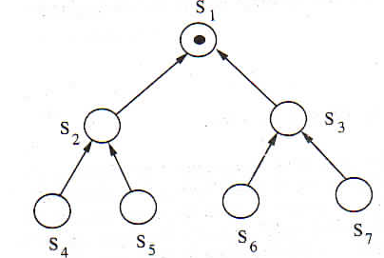
Sites arranged in tree configuration

Slide 127
The Algorithm
Requesting the critical section
1. When a site wants to enter the CS,
- it sends a REQUEST to the upward node provided it does not hold token its request_q is empty.
- It then adds its request to its request_q.
- Non-empty request_q indicates site has sent a REQUEST message to root for top entry in its request_q

Slide 128
2. Site on path to root receiving the request messsage
- places REQUEST on its request_q
- and sends REQUEST message along directed path to root if it has not sent out REQUEST message on its outgoing edge.
Root on receiving REQUEST
- send token to the site from which it received REQUEST message
- Set its holder variable to point at that site.

Slide 129
4. When a site receives token,
- it deletes top entry from request_q,
- sends token to that site indicated in the entry, - set its holder variable to point at that site.
- If its request_q is non-empty , then the site sends REQUEST message to the site pointed at by the holder variable.

Slide 130
Executing Critical section
5. A site enters the CS when it receives the token and its own entry is on top of its request_q
- the site deletes top entry from its request_q and enters the CS

Slide 131
Releasing the critical section
6. if its request_q is nonempty,
- it deletes the top entry from its request_q
- sends token to that site
- sets its holder variable to point at that site

Slide 132
7. if its request_q is nonempty at this point,
- site sends a REQUEST message to the site
which is pointed at by holder variable
Correctness
- the algorithm is free from deadlocks since acyclic nature eliminates circular wait

Slide 133
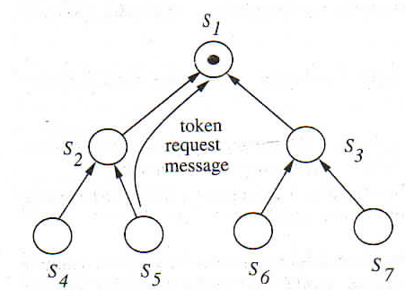
Site S₅ is requesting the token

Slide 134
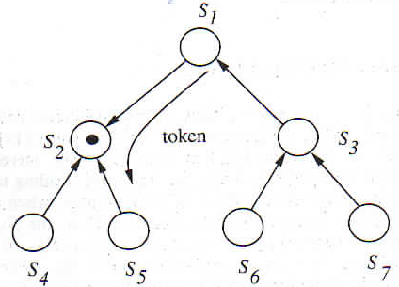
Token is in transit to S₅

Slide 135
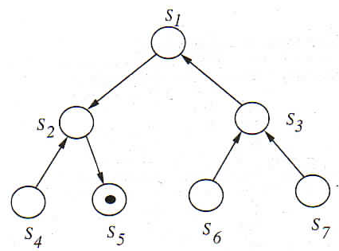
State after S₅ has received the token

Slide 136
Performance
Average message complexity is O(log N)
- average distance between any nodes in a tree with N nodes is O(log N)
Synchronization delay is (T log N)/ 2
- the average distance between two sites to successively execute CS is (log N)/2

Slide 137
DISTRIBUTED DEADLOCK DETECTION

Slide 138
PRELIMINERIES
The System Model
The problem of deadlocks in distributed system is studied under following model:
The systems have only reusable resources
Processes are allowed only exclusive access to resources
There is only one copy of each resource

Slide 139
Process can be in one of the two states :
(i) Running (active) :
- process has all the needed resources
- it is either executing or is ready for execution
(ii) Blocked:
- it is waiting to acquire some resources

Slide 140
Resource vs. Communication Deadlocks
There are two types of deadlocks:
(i) Resource Deadlock:
processes wait for several resources and cannot proceed until they acquire all resources
a set of processes is resource deadlocked if each process in the set request resource held by other process in the set

Slide 141
(ii) Communication Deadlock:
a set of processes is communication-deadlocked if:
- each process in the set is waiting to communicate with other process in the set of processes
- no process in the set initiates further communication until it receives communication for which it is waiting

Slide 142
The Graph-Theoretic Model
(i) Resource allocation graph
It is a bi-partite directed graph that models State of process-resource interaction
Nodes correspond to processes and resources in the system which are connected by two types of edges
Request edge – represents pending request by an edge directed from requesting process to requested resource
Assignment edge – represents resource assignment, by an edge directed from assigned resource to assigned process

Slide 143
(ii) Wait-For Graphs (WFG) :
Is a directed graph that models system state
Nodes – correspond to processes
A directed edge from P₁ to P₂ indicates that P₁ is blocked and is waiting for resource held by P₂
System is deadlocked if and only if there is a directed cycle in WFG

Slide 144
DEADLOCK HANDLING STRATEGIES IN DISTRIBUTED SYSTEMS
1. Deadlock Prevention: can be achieved by
having process acquire all needed resources simultaneously before it begins execution
Here a process request (release) remote resource by sending a request message (release message)

Slide 145
Drawbacks
It decreases the system concurrency and is inefficient
A set of processes can become deadlocked in resource acquiring phase
Future resource requirements are unpredictable
Preempting the process that holds the resource

Slide 146
2. Deadlock Avoidance
Resource is granted to a process if resulting global system state is safe
Deadlock avoidance is impractical in distributed systems due to the following reasons:
a) Every site has to maintain information on global state of the system which results in
- huge communication requirements and
- extensive communication costs

Slide 147
b) Process of checking for safe state must be mutually exclusive
- this will limit concurrency and throughput
c) due to large number of processes and resources checking for safe state will be computationally expensive

Slide 148
3. Deadlock Detection
Deadlock detection in distributed system has two favorable conditions:
Once a cycle is formed in WFG it persists until it is detected and broken
Cycle detection can proceed concurrently along with normal activities of the system
Therefore deadlock handling in distributed system is focused on deadlock detection

Slide 149
ISSUES IN DEADLOCK DETECTION AND RESOLUTION
Deadlock Detection:
Deadlock detection involves two issues:
- Maintenance of WFG and
- Search of WFG for cycles
A correct deadlock detection algorithm must satisfy the following two conditions:
Progress – No undetected deadlocks : -
- the algorithm must detect all existing deadlocks within finite time

Slide 150
- once a deadlock has occurred the deadlock detection algorithm must continuously progress until it is detected
Safety – No false deadlocks :
- the algorithm should not report deadlocks that does not exist (called phantom deadlocks)
- in distributed system sites may detect cycles whose different segments were existing in the system at different times

Slide 151
Deadlock Resolution :
Involves breaking existing wait-for dependencies in the system in WFG
Involves rolling back one or more processes that are deadlocked and assigning their resources to blocked process
When wait-for dependency is broken corresponding information should be immediately cleaned from the system

Slide 152
CONTROL ORGANIZATION FOR DISTRIBUTED DEADLOCK DETECTION
Centralized Control
Central control site constructs global WFG
Control site maintain global WFG constantly or may build it whenever deadlock detection is carried out
It is conceptually simple and easy to implement
It has single point of failure – the control site

Slide 153
Distributed Control
Responsibility of deadlock detection is shared among all sites
Several sites participate in detection of global cycle.
It is not vulnerable to a single point of failure
Deadlock detection is initiated when a waiting process is suspected to be part of deadlock cycle
Distributed deadlock detection algorithms are difficult to design

Slide 154
Hierarchical Control
Sites are arranged in hierarchical fashion
A site checks for cycles only in descendents
It gets best of both centralized and distributed
It require special care while arranging the sites in hierarchy

Slide 155
Ho-Ramamoorthy Algorithm
Two centralized deadlock detection algorithms were given
The Two-Phase Algorithm
Each site maintains a status table of all processes initiated at that site
Status of a process includes all resources locked and all resources being waited upon.

Slide 156
periodically designated site
- requests the status table from each site.
- then constructs WFG from these tables
- searches for cycle(s).
If no cycles then system is free from deadlocks
Otherwise (if cycle exists), designated site request for status tables again from all sites.
Construct WFG using only the transactions that are common to both reports.

Slide 157
If the same cycle is detected again, system is declared to be in deadlock
cycles in wait-for conditions of transactions common in two consecutive reports need not result in a deadlock
Hence, this algorithm detects false deadlocks

Slide 158
The One-Phase Algorithm :
It requires only one status report
Each site maintains 2 status tables: resource status table and process status table.
Resource table: keeps track of transactions that have locked or are waiting for resources.
Process table: keeps track of resources locked by or waited for by all transactions at that site.

Slide 159
Periodically, the designated site requests both the tables from every site.
the designated site constructs a WFG from transactions for which an entry in resource table matches corresponding entry in process table
It then searches WFG for cycles
If No cycle is found, system is not deadlocked.
A cycle means a deadlock

Slide 160
one phase algorithm does not detect false deadlocks
it eliminates inconsistencies introduced by unpredictable message delays
Example :
- if resource table at S₁ indicates that resource R₁ is waited upon by process P₂ (R₁ ← P₂ )
- and process table at S₁ indicates that P₂ is waiting for resource R₁ (P₂ →R₁ )
Then edge P₂ →R₁ in constructed WFG reflects correct system state

Slide 161
One- phase algorithm is faster and require fewer messages when compared to two-phase algorithm
It requires more storage since
Each site maintains two status tables
Each site exchange bigger message containing two tables

Slide 162
Distributed Algorithms
Path-pushing: resource dependency information disseminated through designated paths (in the graph).
Edge-chasing: special messages or probes circulated along edges of WFG. Deadlock exists if the probe is received back by the initiator.
Diffusion computation: queries on status sent to process in WFG.
Global state detection: get a snapshot of the distributed system. Not discussed further in class.

Slide 163
A Path-Pushing Algorithm
Here information about wait-for dependencies is propagated in the form of paths
Obermarck’s Algorithm
Processes are referred to as transactions denoted by T₁, T₂, …, T_{n}
Transactions may contain subtransactions that execute at different sites
At most one subtransaction within a transaction can be executing at a time.

Slide 164
Subtransactions communicate synchronously by passing messages
Obermarck’s algorithm has two interesting features:
The distinguished node called External or Ex abstracts the nonlocal portion of global TWF graph and helps in determining multisite deadlocks
Transactions are totally ordered, which reduces number of messages and decreases deadlock detection overhead.

Slide 165
The Algorithm
Deadlock detection at a site follows the iterative process discussed below:
Site waits for deadlock related information (produced in step 3) from other sites
The site combines received information with its local TWF to build an updated TWF graph
- it detects all the cycles and breaks only the cycles that doesn’t contain the node ‘Ex’
- these cycles are local to this site

Slide 166
For all cycles ‘Ex → T₁ → T₂ → Ex’ which contain node ‘Ex’,
- the site transmits them in string form ‘Ex,T₁,T₂, Ex’ to all site where subtransaction of T₂ is waiting to receive message from the subtransaction of T₂

Slide 167
The algorithm reduces message traffic by
- lexically ordering transactions and
- sending string ‘Ex,T₁,T₂,T₃,Ex’ to other sites only if T₁ is higher thanT₃ in lexical ordering
Highest priority process detects the deadlock.
The algorithm is incorrect because it detects phantom deadlocks

Slide 168
The algorithm sends n(n-1)/2 messages to detect a deadlock involving n sites
Size of message is O(n)
Delay in detecting deadlock is O(n)

Slide 169
The Edge-Chasing Algorithm
Chandy-Misra-Haas’s Algorithm (AND MODEL):
This algorithm uses special message called a probe
A probe is a triplet (i, j, k) denoting it belongs to deadlock detection process initiated for process P_{i}. This probe is sent by the home site of process P_{j} to P_{k}.
Probe message travels along edges of global TWF graph
Deadlock is detected when probe message reaches its initiating process

Slide 170
Terms and data structures used :
P_{j} is dependent on P_{k}, if
- a sequence of P_{j}, P_{i1},.., P_{im}, P_{k} exists
- each process except P_{k} in the sequence is blocked
- each process except P_{j} holds a resource for which previous process in the sequence is waiting

Slide 171
P_{j} is locally dependent on P_{k}, if P_{j} is dependent on P_{k} and both processes are at the same site
For each process system maintains a boolean array dependent_{i} where ,
- dependent_{i}(j) is true if P_{i} knows that P_{j} is dependent on it
- initially dependent_{i}(j) is set to false for all i and j

Slide 172
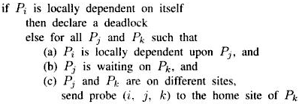
The Algorithm : to determine if a blocked process is deadlocked, System executes the following

Slide 173
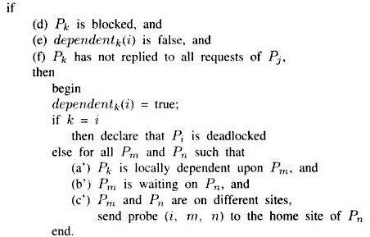
On receipt of probe (i, j, k) the site takes following actions

Slide 174
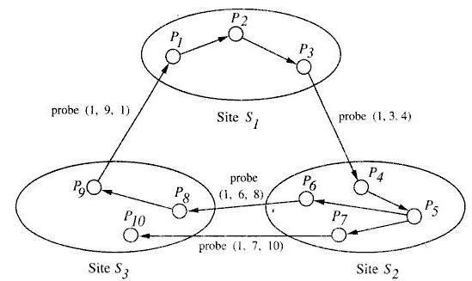
An example of Chandy et al’s edge-chasing Algorithm

Slide 175
The Mitchell-Merritt Algorithm
Each node of TWF graph has two labels : public and private
Private label of each node is unique to that node
Initially both labels at a node has same values
Deadlock is detected by propagating public label of nodes in backward direction in TWF graph

Slide 176
When a transaction is blocked, public and private value of its node in TWF graph is changed to a value
- greater than their previous value and
- greater than public label of blocking transaction
A blocked transaction periodically reads and replaces its public label with that of blocking transaction,
- provided public label of blocking transaction is larger than its own public label

Slide 177
Deadlock is detected when a transaction receives its own public label
Here only one process detects deadlock
To resolve the deadlock the process detecting deadlock aborts itself

Slide 178
Sinha-Natarajan Algorithm:
Transactions are assigned unique priorities
Antagonistic conflicts – occur when a transaction waits for a data object locked by lower priority transaction
Deadlock detection is initiated when antagonistic conflicts occur
The algorithm detects deadlock by circulating probe message through a cycle in global TWF graph

Slide 179
A probe message is a 2-tuple (i ,j) where
- T_{i} is the transaction that initiated deadlock detection and
- T_{j} is the transaction having lowest priority among all transactions
A waiting transaction discards the Probe if it is initiated by lower priority transaction

Slide 180
Deadlock is detected when probe issued by highest priority transaction in the cycle returns to it.
the detector of deadlock aborts lowest priority transaction so as to resolve deadlock

Slide 181
Diffusion Computation Based Algorithm
In this algorithm deadlock detection computation is diffused through the WFG of the system
Chandy-Misra-Haas’s Algorithm (OR MODEL):
Messages used in diffusion computation take the form query(i, j, k) and reply(i, j, k)
- indicate they are part of diffusion computation initiated by process P_{i} and sent from P_{j} to P_{k}
Process can be in active (executing) or blocked (waiting to acquire resource) state

Slide 182
Blocked process initiates deadlock detection by sending query messages to all process from whom it is waiting to receive a message (called dependent set)
If an active process discards the query or reply message received
When a blocked process receives query message, it performs the following actions:

Slide 183
If P_{k} is receiving query message for first time (engaging query), initiated by P_{i} for deadlock detection
- it propagates query message to all processes in dependent list
- sets a local variable num_{k} (i) to the number of query messages sent

Slide 184
if it is not engaging query, P_{k} returns a reply immediately
- provided P_{k} is continuously blocked since it received corresponding engaging query
Local boolean variable wait_{k}(i) at P_{k} denotes it has been continuously blocked
When P_{k} receives a reply (i, j, k) , it decrements num_{k}(i) provided wait_{k}(i) holds
An initiator detects deadlock when it receives reply messages to all query messages it has sent.

Slide 185
The Algorithm
Initiation by a blocked process P_{i}:
send query(i, i , j) to all processes P_{j} in the dependent set DS_{i} of P_{i};
num_{i}(i) := |DS_{i}|; wait_{i}(i) := true;

Slide 186
Blocked process P_{k} receiving query(i, j, k):
if this is engaging query for process P_{k}
then send query(i, k, m) to all P_{m} in its dependent set DS_{k};
num_{k}(i) := |DS_{k}|; wait_{k}(i) := true;
else if wait_{k}(i) then send a reply(i, k, j) to P_{j}.

Slide 187
Process P_{k} receiving reply(i, j, k)
if wait_{k} (i)
then begin
num_{k} (i) := num_{k} (i) - 1;
if num_{k} (i) = 0 then
if i = k then declare a deadlock.
else send reply(i, k, m) to P_{m},
which sent the engaging query

Slide 188
Several diffusion computation may be initiated for a process
Only one diffusion computation may be current for any process at any time
- all others are outdated
Current can be distinguished from outdated using sequence number

Slide 189
Hierarchical Deadlock Detection
The Menasce-Muntz Algorithm
All controllers are arranged in tree fashion
Controllers – manage resources and are responsible for deadlock detection
Controllers at bottom-most level (leaf controllers) manage resources
Others are responsible for deadlock detection

Slide 190
A leaf controller maintains a part of global TWF graph related to allocation of resources at that controller
A nonleaf controller maintains all TWF graphs spanning its children controllers
- it is responsible for detecting all deadlocks involving all of its leaf controllers
Whenever a change occurs in controller’s TWF graph – due to resource allocation, , wait or release it is propagated to parent controller

Slide 191
Parent controller changes TWF graph, searches cycles, and propagates changes upward if needed
A nonleaf node can get up-to-date information of its children’s TWF either continuously or periodically

Slide 192
The Ho-Ramamoorthy Algorithm
Here Sites are grouped into several disjoint clusters
Periodically a site is chosen as central control site
The central control site dynamically chooses control site for each cluster
central control site requests intercluster transaction status information and wait-for relation from each control site

Slide 193
Control site collects status tables from all sites within its cluster
applies one-phase deadlock detection algorithm
It sends, intercluster transaction status information and wait-for relation to central control site

Slide 194
central control site then
merges intercluster transaction status information received
Constructs a system WFG
Searches for cycles
Control site detects all deadlocks within its cluster
Central Control site detects all intercluster deadlocks

Slide 195
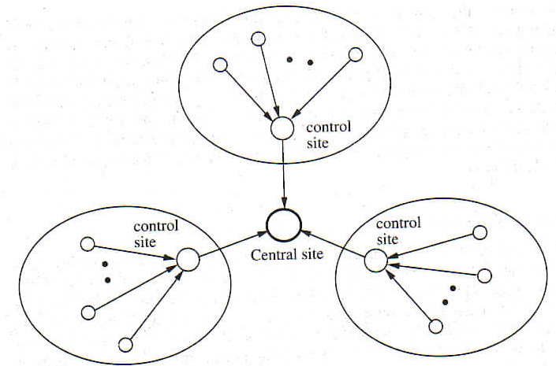
Hierarchical organization in Ho-Ramamoorthy Algorithm

